Slide 1


AI Application System
(ISE4132)
Week _ Lecture
ISE Department Prof. Mehdi Pirahandeh
School of Global Convergence Studies

Slide 2

Contents
Introduction to Deep Learning
Example in Deep Learning using Tensorflow
Example in OpenAI Gym environments
School of Global Convergence Studies

Slide 3
Introduction to
Deep Learning

Slide 4
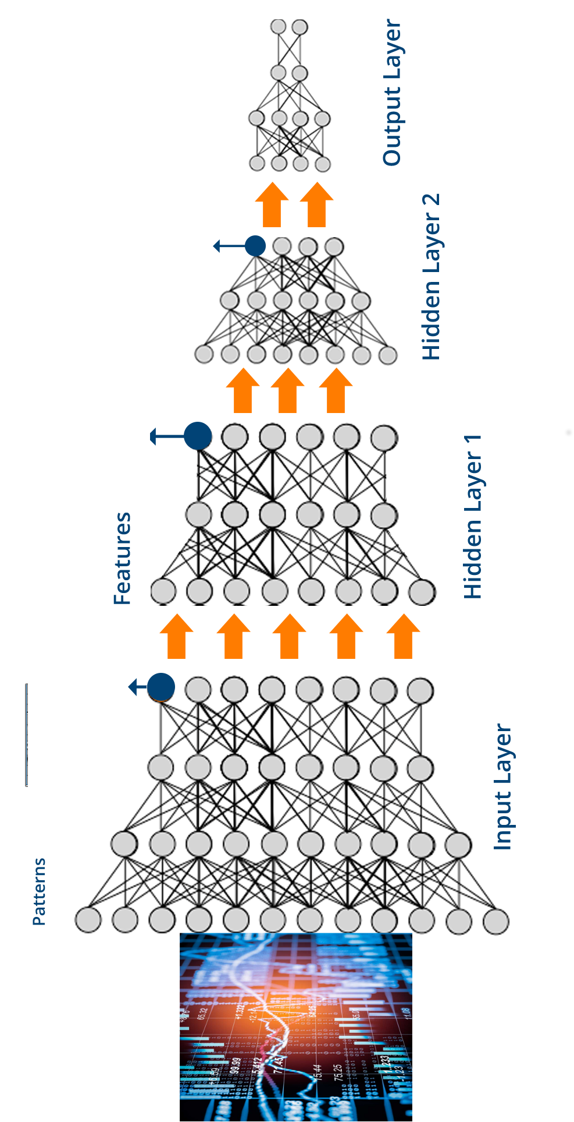

Introduction to Deep Learning
Tensorflow
OpenSource framework developed by Google researchers to run machine learning, deep learning and other statistical and predictive analytics workloads.
Tensorflow applications can run on either conventional CPUs or higher-performance graphics procession units (GPUs), as well as Google’s own tensor processing units (TPUs)
School of Global Convergence Studies

Slide 5
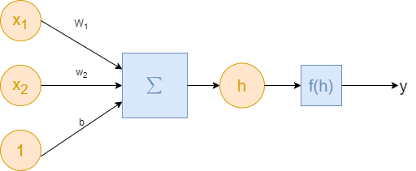
Introduction to Deep Learning
Neural Networks
Deep Learning is based on Artificial Neural Networks which are made up of neurons. A neuron takes inputs, calculates the weighted sum and then passes the sum through some kind of non-linear function (called activation function) as show below
School of Global Convergence Studies

Slide 6
II. Example in
Deep Learning
using Tensorflow

Slide 7
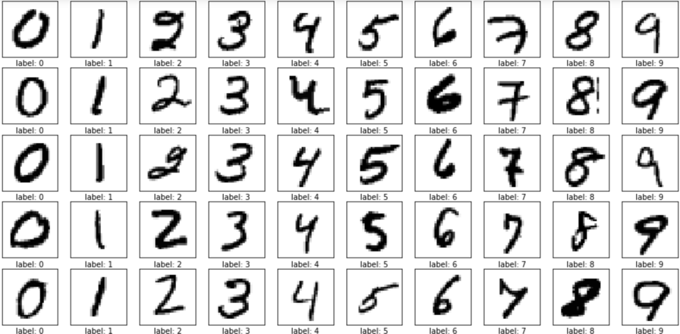
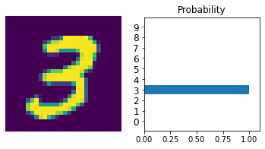
Example in Deep Learning using Tensorflow
In this example we will use MNIST dataset and create a neural network in Tensorflow.
MNIST dataset has images 28x28 pixels = 784 pixels
We will have 10 units at the output layer to signify the digit (0-9) the image belongs to.
We will use the network to train a model to take MNIST data as input and produce the class it belongs to.
*(reder to deep-learning-intro.ipynb)
School of Global Convergence Studies

Slide 8
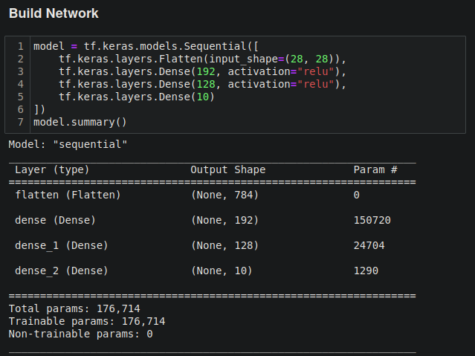
Example in Deep Learning using Tensorflow
School of Global Convergence Studies

Slide 9
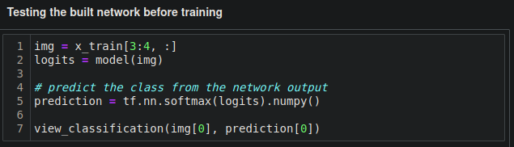
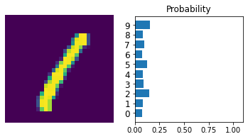
Example in Deep Learning using Tensorflow
School of Global Convergence Studies

Slide 10
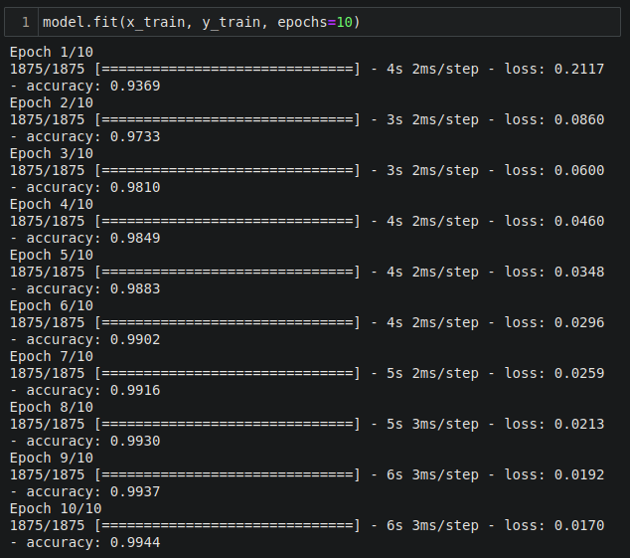
Example in Deep Learning using Tensorflow
Model Training
After each epoch `accuracy` increased and after the 10th epoch accuracy is 99.44%
School of Global Convergence Studies

Slide 11
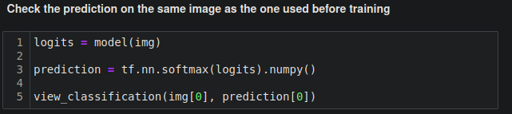
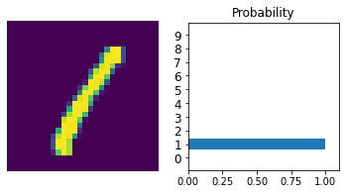
Example in Deep Learning using Tensorflow
After Training Before Training
School of Global Convergence Studies

Slide 12
III. Example in OpenAI
Gym Environments

Slide 13
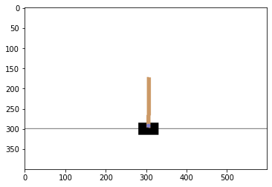
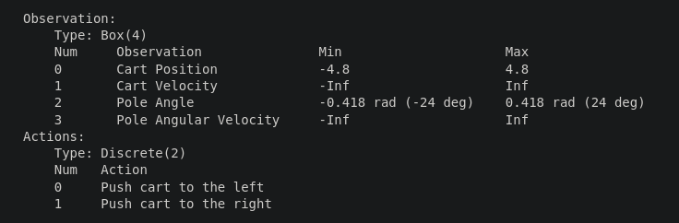
Example in OpenAI Gym Environments → (DQN)
Deep Q-Network (DQN) Implementation
Environment: “CartPole-v1”
We will build a DQN agent using a simple network. We now need to build a neural network that can map states/observations to state q-values. The observation space and action space is as given below for CartPole
School of Global Convergence Studies

Slide 14
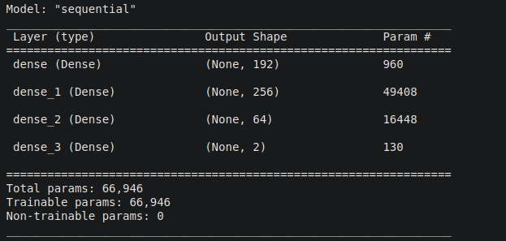
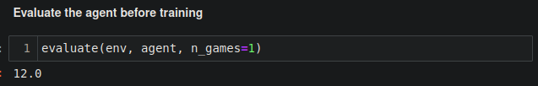
Example in OpenAI Gym Environments → (DQN)
Neural Network used for model
Agent before training
School of Global Convergence Studies

Slide 15
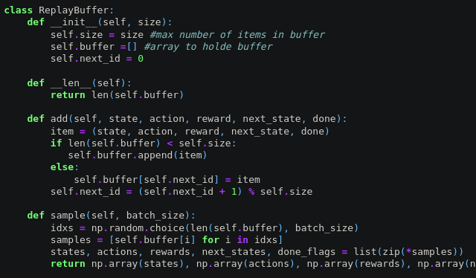
Example in OpenAI Gym Environments → (DQN)
Case #1
Experience Replay (ReplayBuffer)
We will use the replay buffer we saw in chapter 4 listings. Replay buffer is very important in DQN to break the correlation between samples. We use a behavior policy to sample from the environment and store the transitions (s,a,r,s',done) into a buffer. These samples are used multiple times in a learning making the process sample efficient.
The interface to ReplayBuffer is:
exp_replay.add(state, action, reward, next_state, done) - saves (s,a,r,s',done) tuple into the buffer
exp_replay.sample(batch_size) - returns states, actions, rewards, next_states and done_flags for batch_size random samples.
len(exp_replay) - returns number of elements stored in replay buffer.
School of Global Convergence Studies

Slide 16
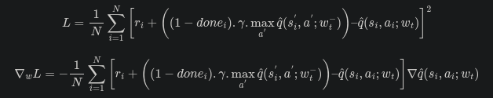
Example in OpenAI Gym Environments → (DQN)
Learning with Q-Learning
We will calculate average TD error per batch using the following equation
*(refer to `compute_td_loss()` in `source.py`
School of Global Convergence Studies

Slide 17

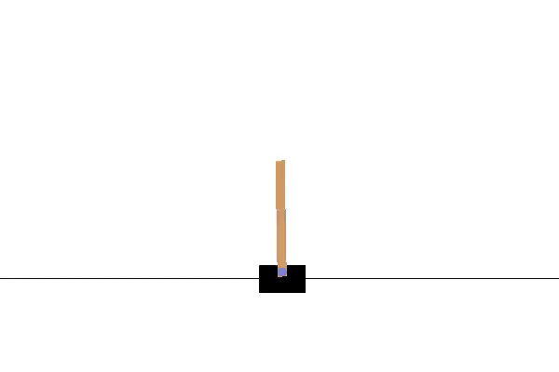

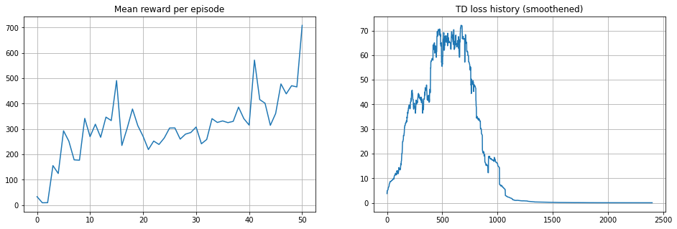
Example in OpenAI Gym Environments → (DQN)
Training
timesteps_per_epoch = 1
batch_size = 32
total_steps = 50,000
Recorded animation Before training
After training
School of Global Convergence Studies

Slide 18
Example in OpenAI Gym Environments → (DQN)
Case #2
Prioritized Experience Replay (PrioritizedReplayBuffer)
We will use the replay buffer we saw in chapter 4 listings. Replay buffer is very important in DQN to break the correlation between samples. We use a behavior policy to sample from the environment and store the transitions (s,a,r,s',done) into a buffer. These samples are used multiple times in a learning making the process sample efficient.
The interface to ReplayBuffer is:
exp_replay.add(state, action, reward, next_state, done) - saves (s,a,r,s',done) tuple into the buffer
exp_replay.sample(batch_size) - returns states, actions, rewards, next_states and done_flags for batch_size random samples.
len(exp_replay) - returns number of elements stored in replay buffer.
update_priorities(idxs, new_priorities) - returns nothing.
School of Global Convergence Studies

Slide 19
Example in OpenAI Gym Environments → (DQN)
Learning with Q-Learning
We will calculate average TD error per batch using the following equation
*(refer to `compute_td_loss_priority_replay()` in `source.py`
School of Global Convergence Studies

Slide 20
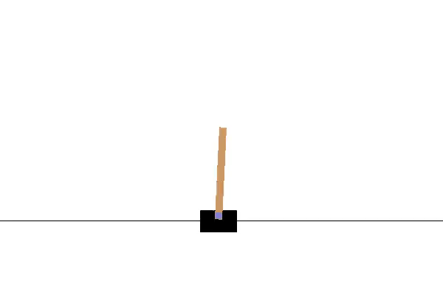

Example in OpenAI Gym Environments → (DQN)
Training
timesteps_per_epoch = 1
batch_size = 32
total_steps = 50,000
Recorded animation Before training
After training
School of Global Convergence Studies

Slide 21
Assignment #1
Try to run these approaches for another environment of your choice from OpenAI Gym
Try to enhance the network using various variants

